Slide 1
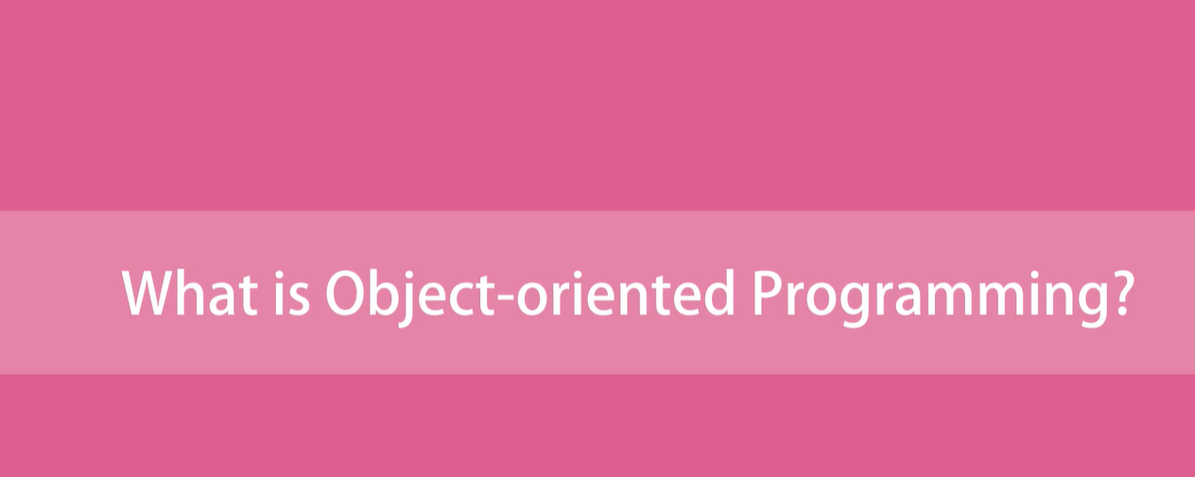

Slide 2
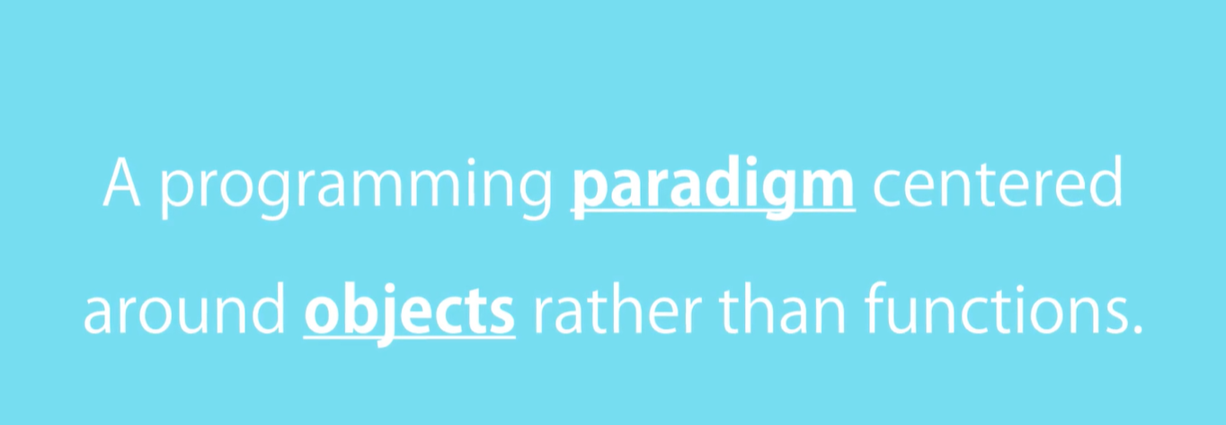

Slide 3
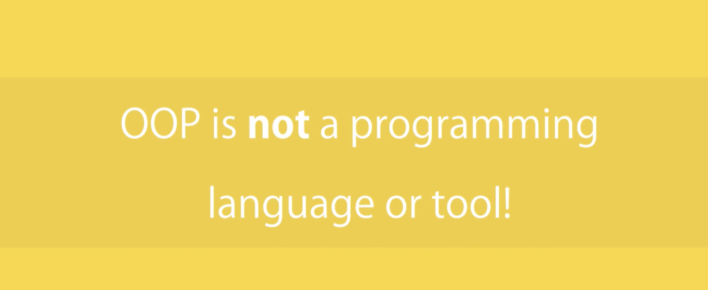

Slide 4
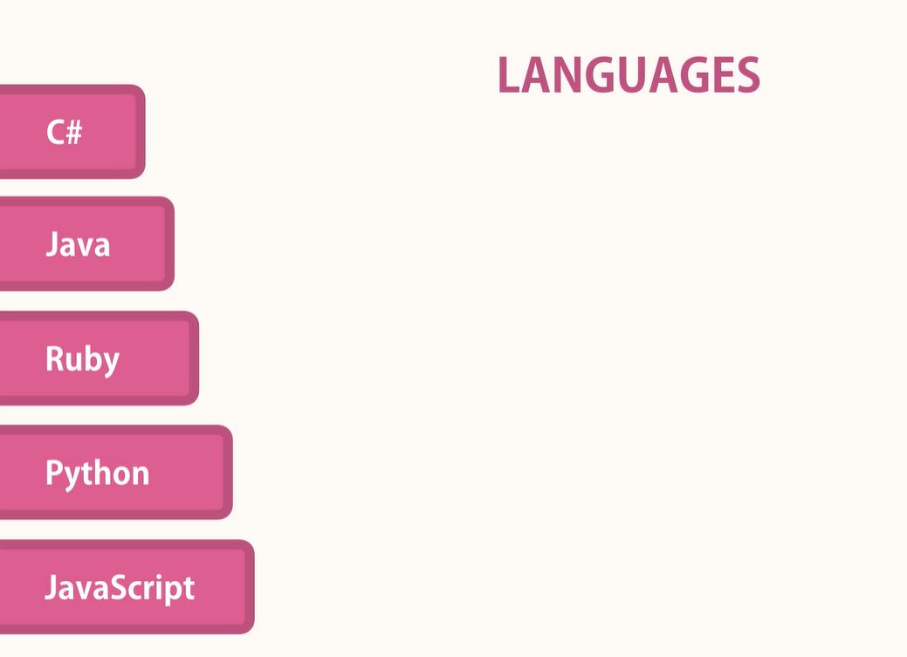

Slide 5


Slide 6
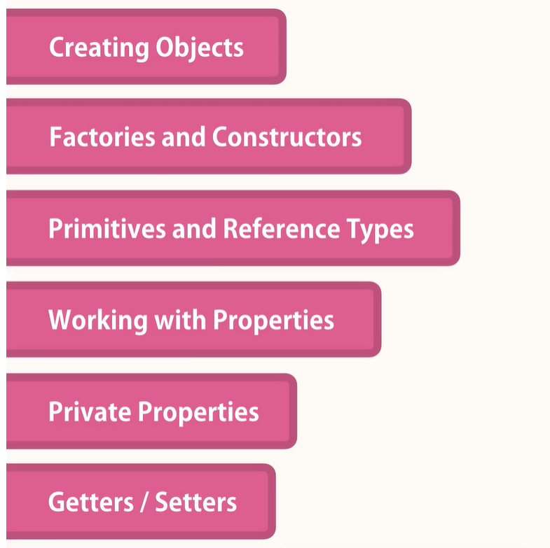

Slide 7
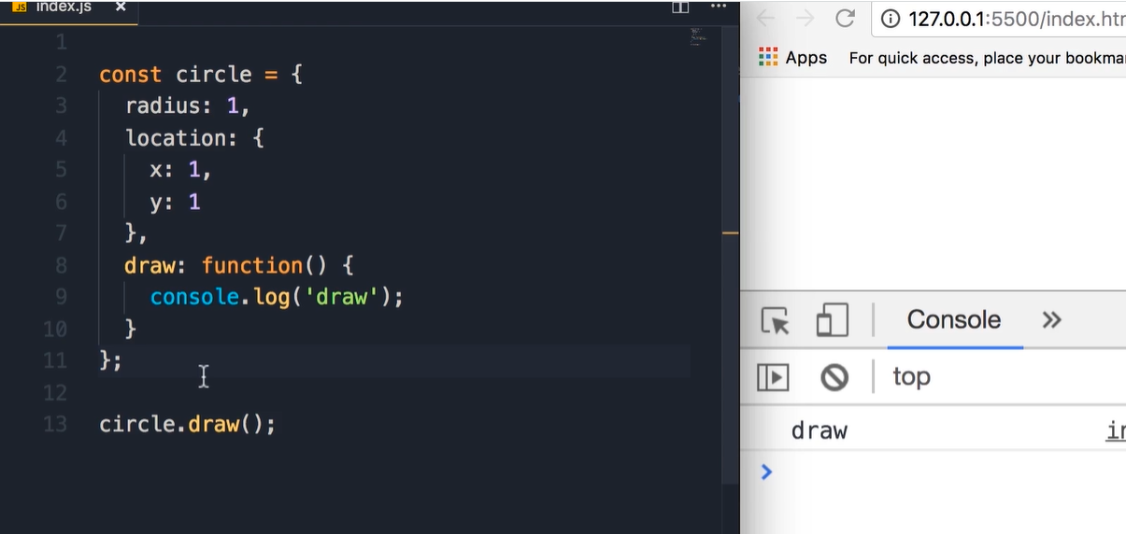
Define an object

Slide 8
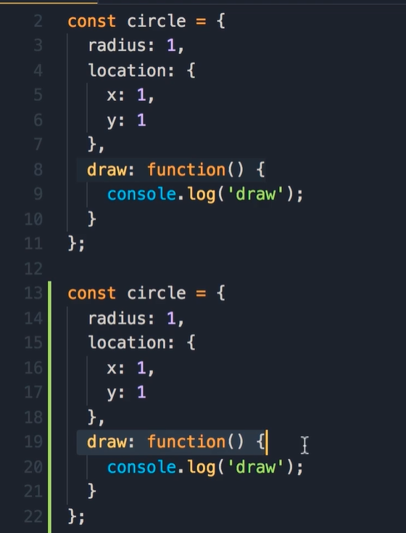
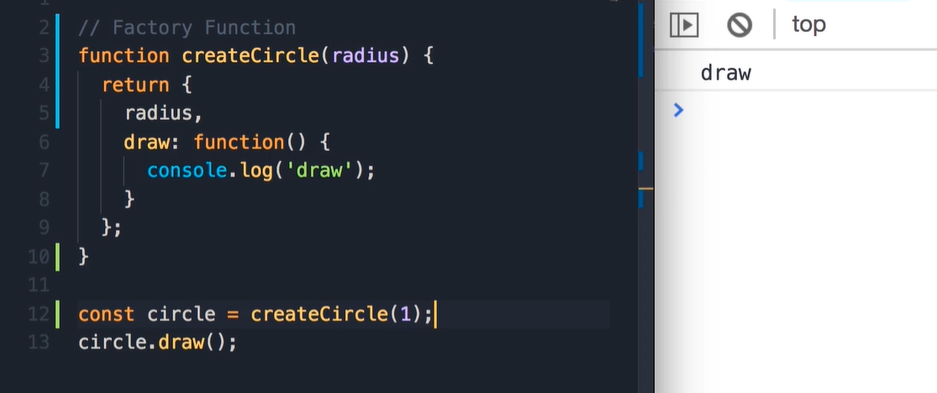
Factories
If we want to create several objects. But what we will do if there is a bug !!! We will need to fix the bug in several places.
Using factory, we create objects.

Slide 9
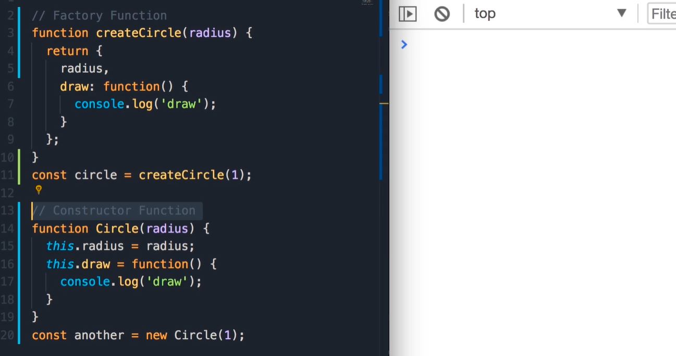
Constructors
Naming convention of constructor function should start with uppercase

Slide 10
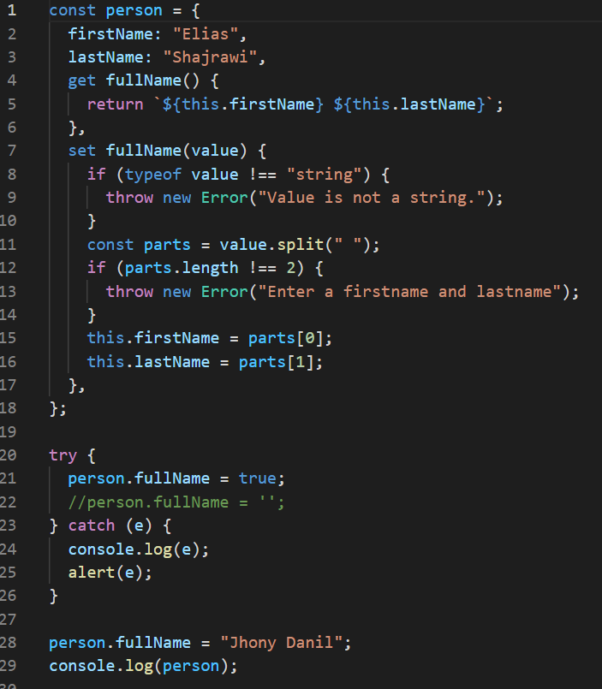
Getters/Setters

Slide 11
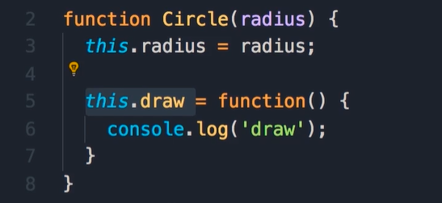
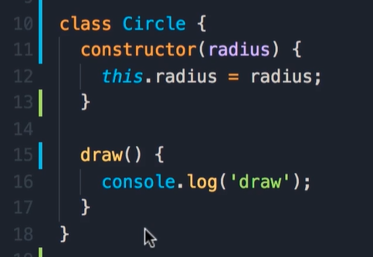
ES6 Classes
Before
After
New way to create objects and implement inheritance., using classes.
But these classes are not like classes we have in c#, Java … there essentially syntactic sugar over prototypical inheritance.

Slide 12
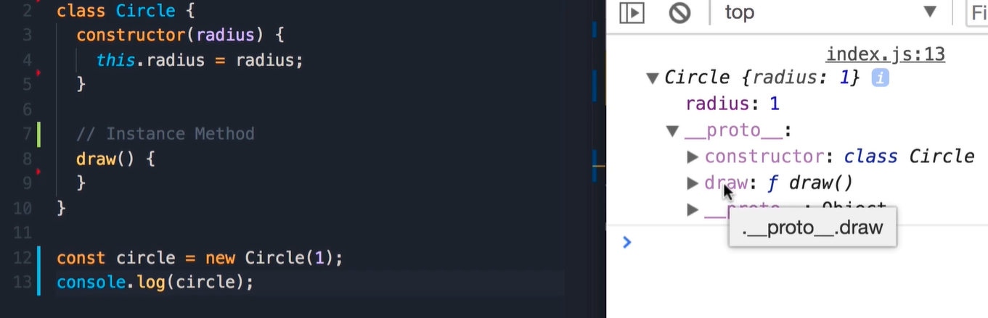
Static Methods vs Instance Methods
Instance method available on an instance of a class, which is an object.

Slide 13
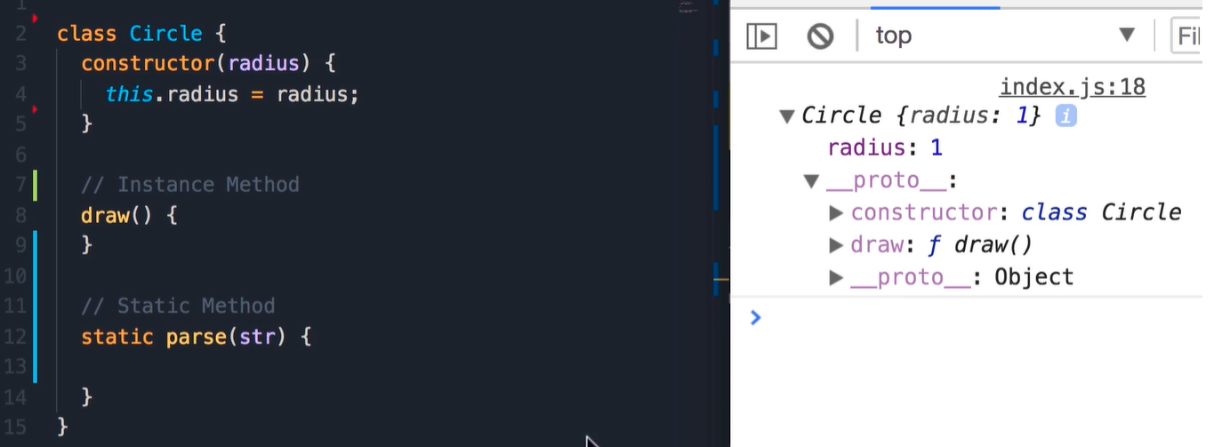
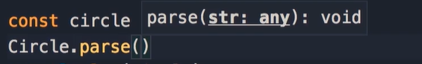
Static Methods vs Instance Methods
Static methods are available on the class itself. Not the object instance
We use static methods to create utility functions that are not specific to a given object.
Accessible on the class reference and not on the object itself.

Slide 14
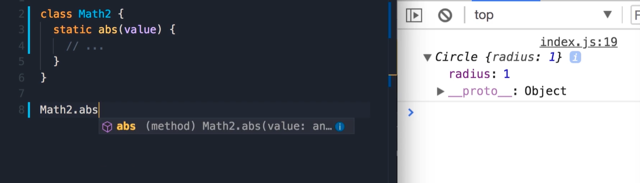
Static Class Example

Slide 15
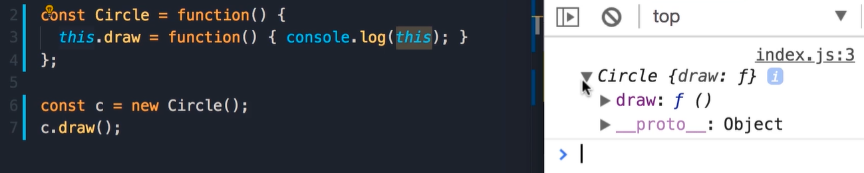
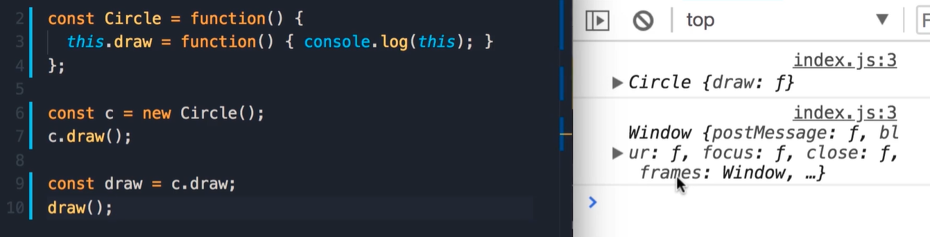
This keyword
Circle object?
Window object!
In line 7 we have a method call, because we are calling a method on an
Object. In this case `this` in this function will point to this object, which
Is our circle object.
In line 10 , it’s a Function call, because we’re calling this on a stand-alone function that is not part of
An object.
So:
When we call this method as a function, by default this will point to the global object which is the window object.

Slide 16
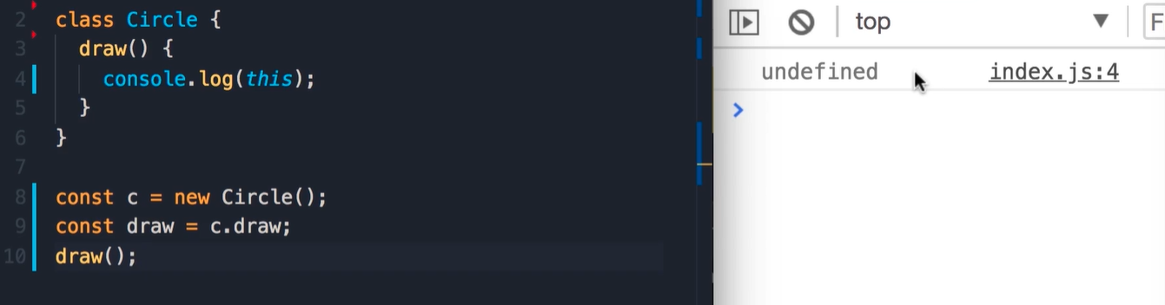
This keyword
We get undefined.
Because by default our JavaScript code run under strict mode, witch help us from accidently modifying the global object

Slide 17
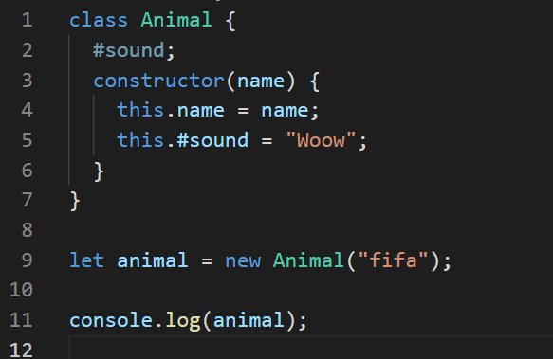
Privet properties
Abstraction: hidden the details and complexity and showing only the essential parts
Class fields are public by default, but private class members can be created by using a hash # prefix.
The privacy encapsulation of these class features is enforced by JavaScript itself.
class ClassWithPrivateField {
#privateField;
}
class ClassWithPrivateMethod {
#privateMethod() {
return 'hello world';
}
}
class ClassWithPrivateStaticField {
static #PRIVATE_STATIC_FIELD;
}
class ClassWithPrivateStaticMethod {
static #privateStaticMethod() {
return 'hello world';
}
}
class ClassWithPrivateField {
#privateField;
constructor() {
this.#privateField = 42;
this.#undeclaredField = 444; // Syntax error
}
}
const instance = new ClassWithPrivateField()
instance.#privateField === 42; // Syntax error

Slide 18
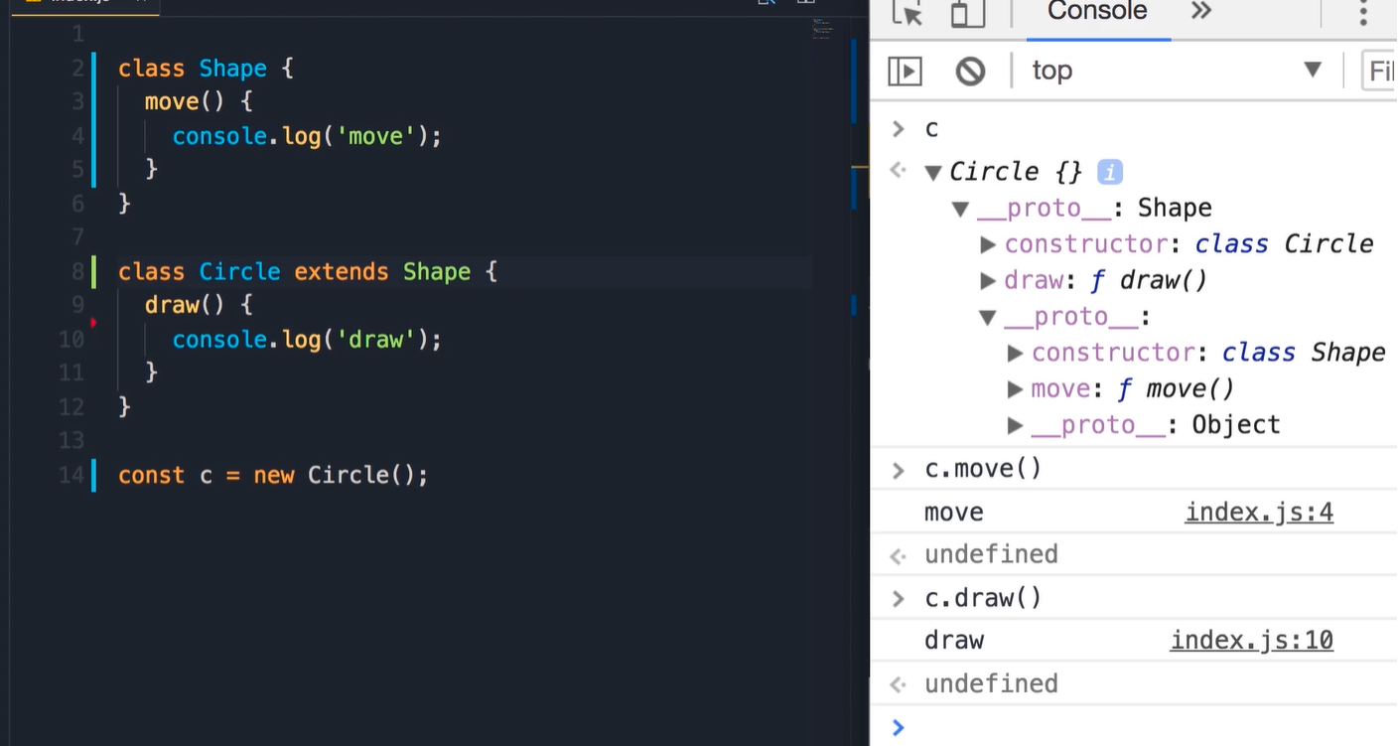
Inheritance

Slide 19
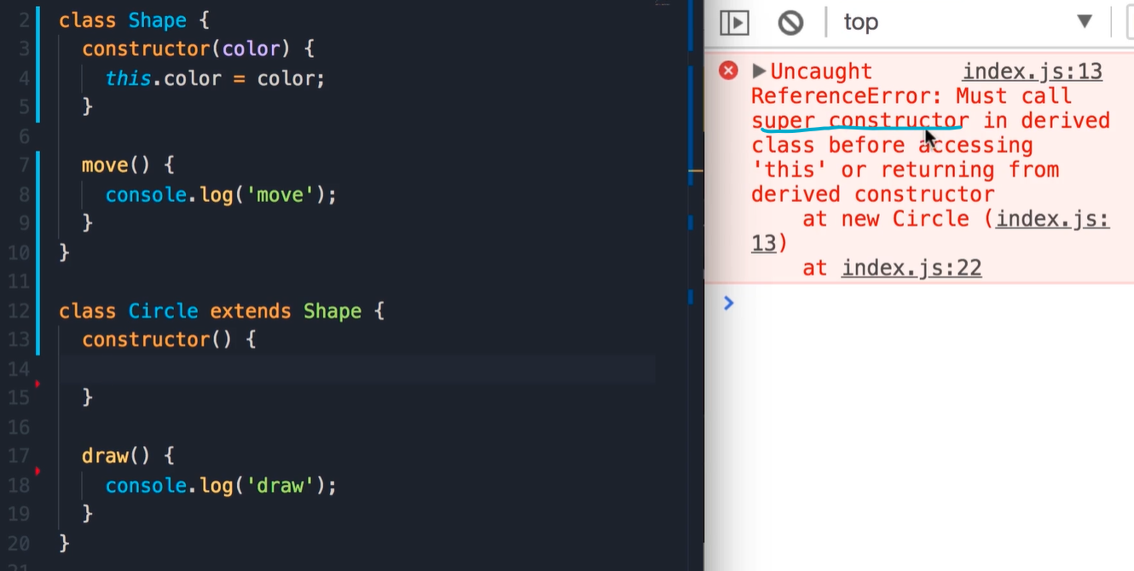
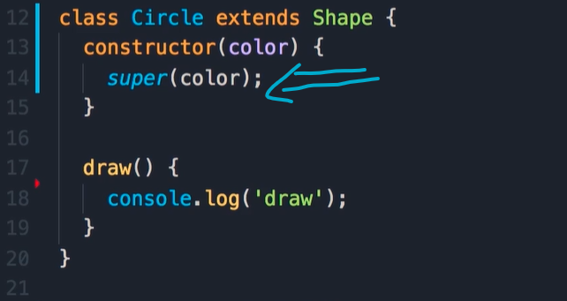
Inheritance
Let assume that all the Shapes need to have colors!

Slide 20
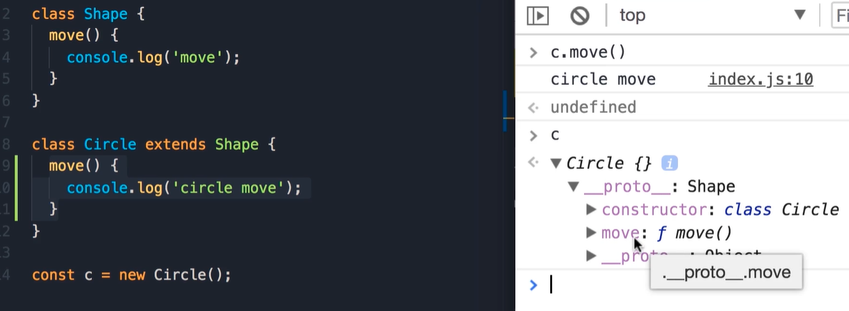
Method overriding
When we have method in base class and we want to change method implementation in the drive class.
As u can see from the example that the move method in Circle class was used.
JavaScript first look if there is move method in the Circle object then the JavaScript engine look at the prototype of this object and find the move method.

Slide 21
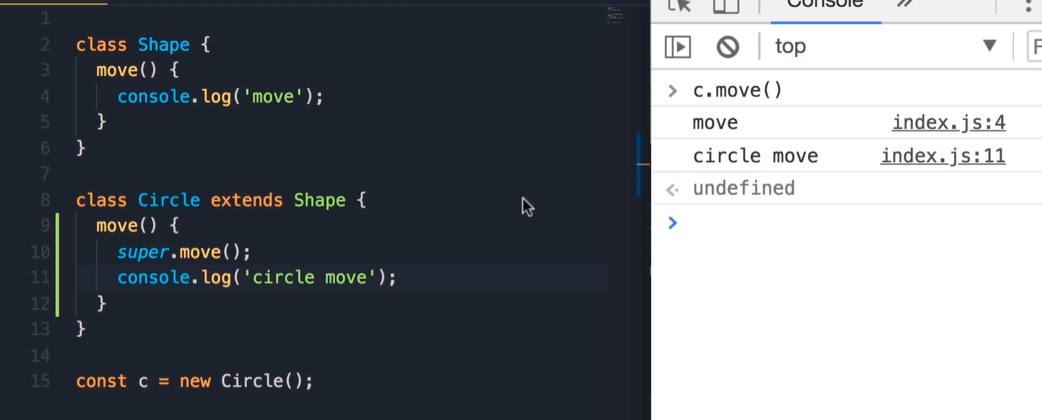
Parent method access
Sometimes we want to access some of the method that already defined in the parent object. In this case we can call it by using the super keyword.

Slide 22
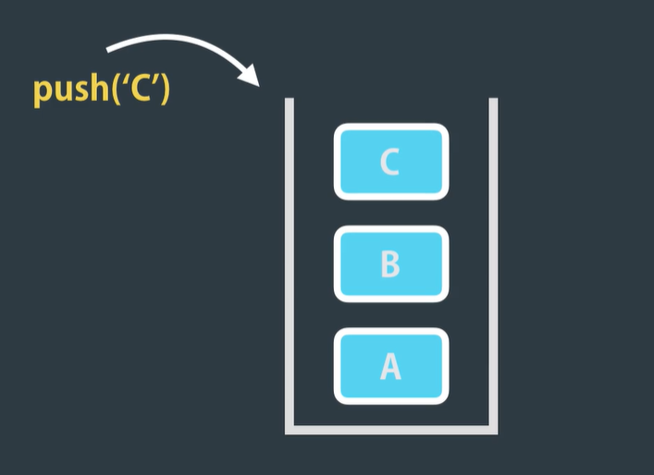
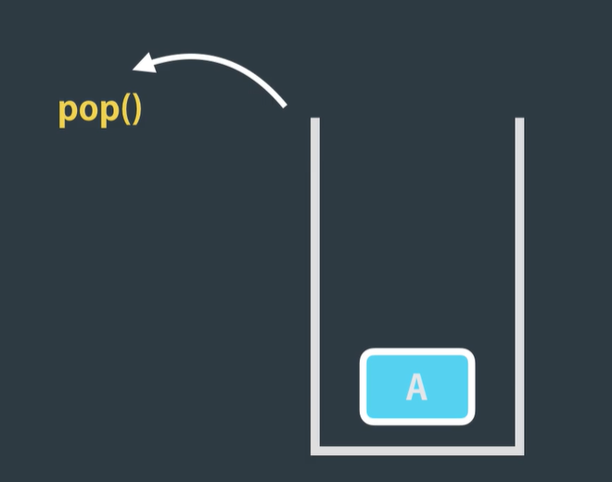
Exercise
Implement a STACK using es6 classes

Slide 23
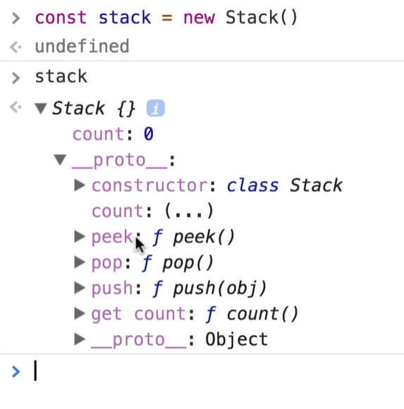
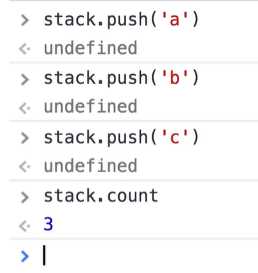
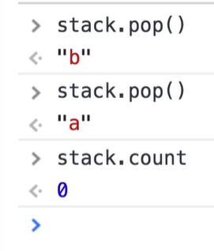
Exercise STACK example

Slide 24
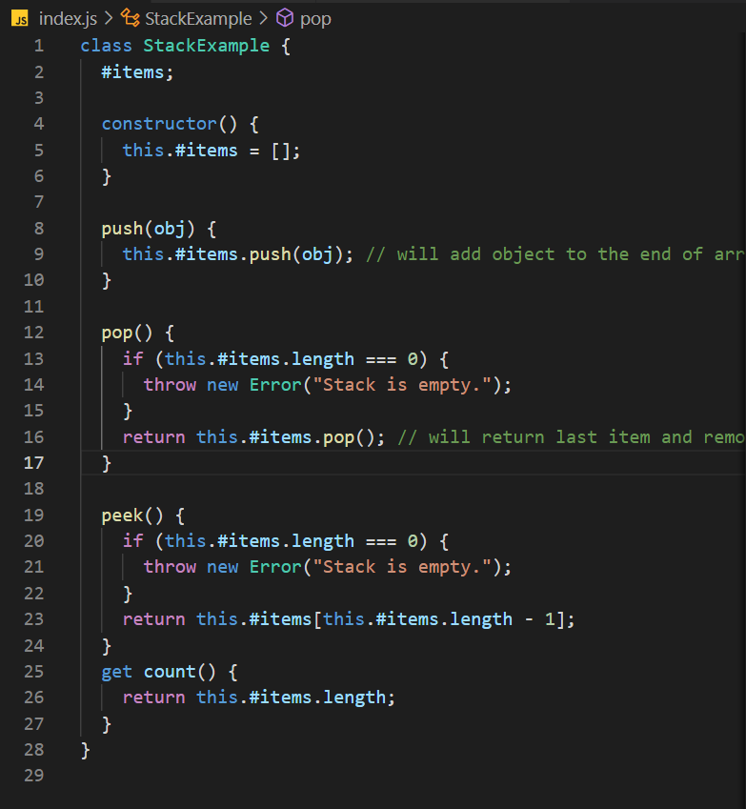
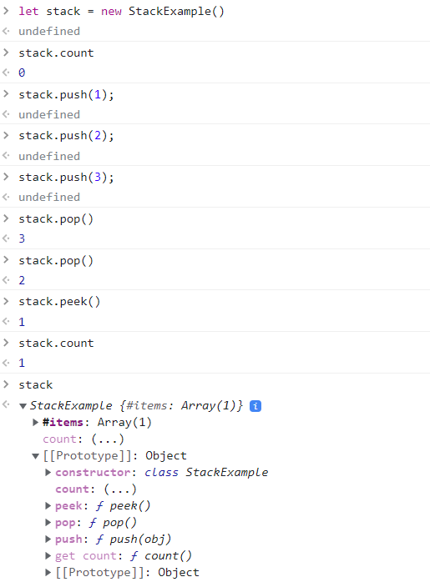
Solution

Slide 25
Set, Map, WeakSet, WeakMap

Slide 26
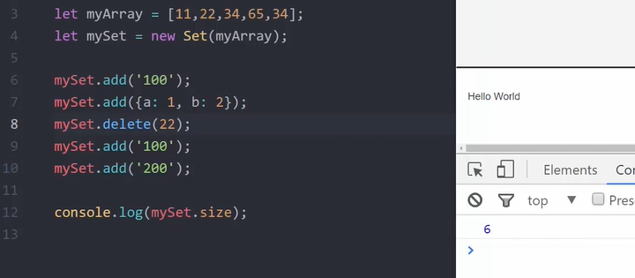
Set
Set objects are collections of values. You can iterate through the elements of a set-in insertion order
each value in the Set must be unique

Slide 27
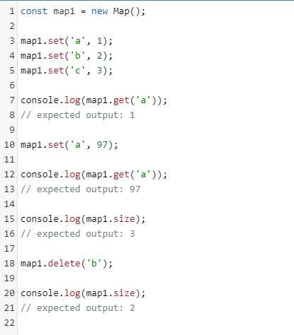
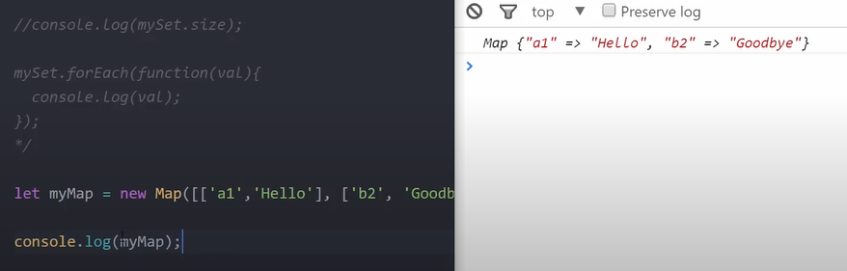
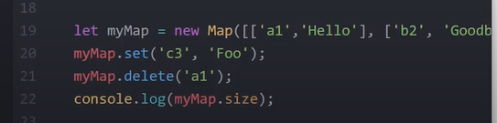
Map
The Map object holds key-value pairs and remembers the original insertion order of the keys. Any value (both objects and primitive values) may be used as either a key or a value.

Slide 28
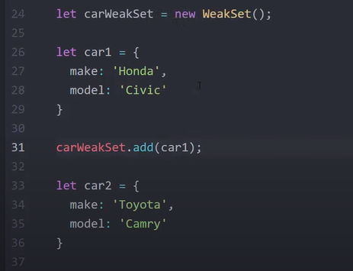
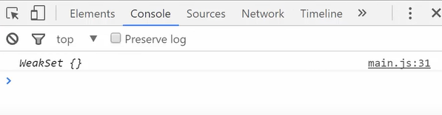
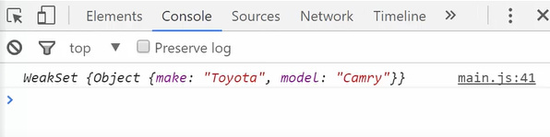
WeakSet
WeakSet in JavaScript is used to store a collection of objects. It adapts the same properties of that of a set i.e., does not store duplicates. The major difference of a WeakSet with the set is that a WeakSet is a collection of objects and not values of some type.

Slide 29
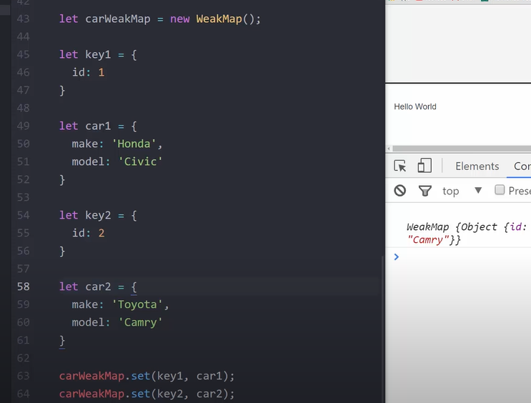
WeakMap
A WeakMap is a collection of key/value pairs whose keys must be objects, with values of any arbitrary JavaScript type, and which does not create strong references to its keys. That is, an object’s presence as a key in a WeakMap does not prevent the object from being garbage collected.

Slide 30
Modules
In all the examples so far, we have written all the code inside of one file index.js but that not how we build real world applications.
So, we should split our code into multiple files, and we call each of this
Files a module.
Modularity, we can increase the maintainability of our application.
We can reuse one or mote of there modules in different part of an application or in different applications.
We can abstract code, so we can apply abstraction principle, which means we can hide some if the complexity in a module, and only expose the essentials.

Slide 31


Slide 32


Slide 33


Slide 34
Show In Code StackExample should be moved to new file

Slide 35
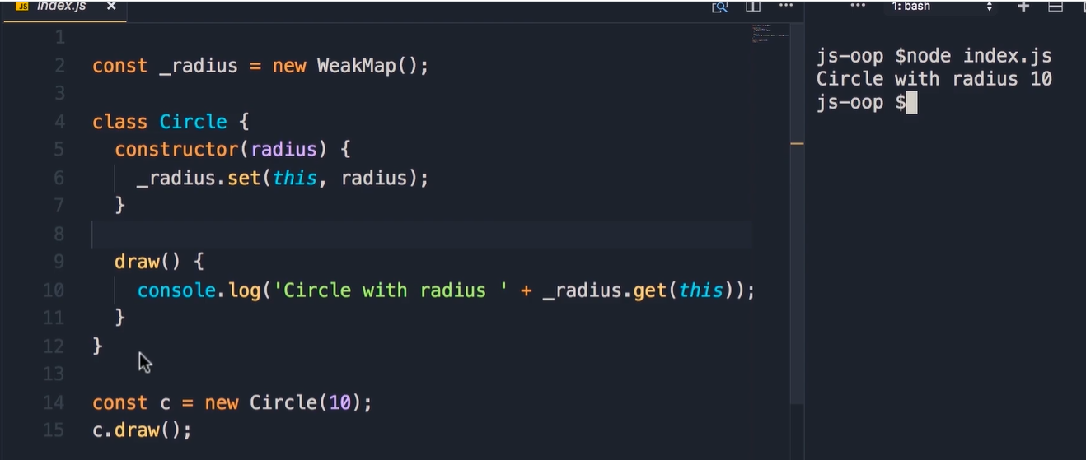
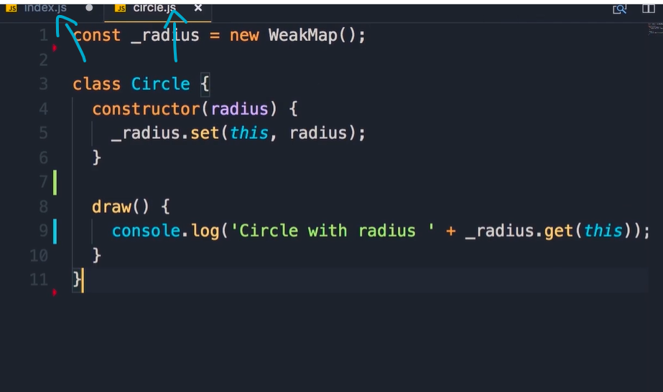
Before
After
By default, everything that we define in a module is considered to be private. So it won’t be accessible to the outside, unless we explicitly export it.

Slide 36
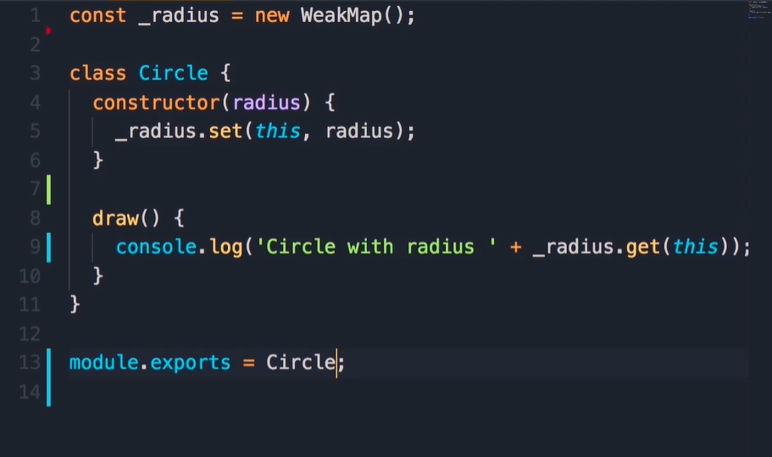
Export objects in Node
module keyword refer to the current module, the module have export property and we can add one or more properties to
this object

Slide 37
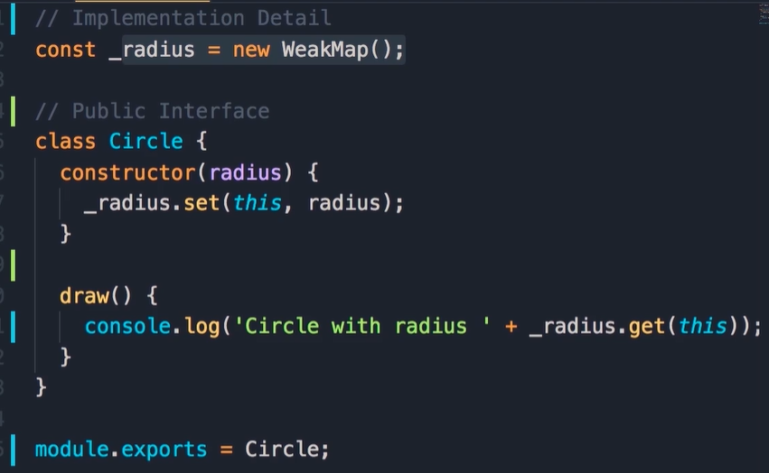
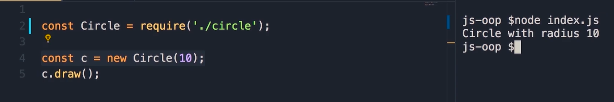
Import module
This code in file index.js
This code in file circule.js
We use the require function. This require function is part of the commons, so common JS format defines this require function. As well the module.exports.
When we use require function, we get what defined in the module.exports
_radius is not accessible outside the module
What we exported its called Public Interface.

Slide 38
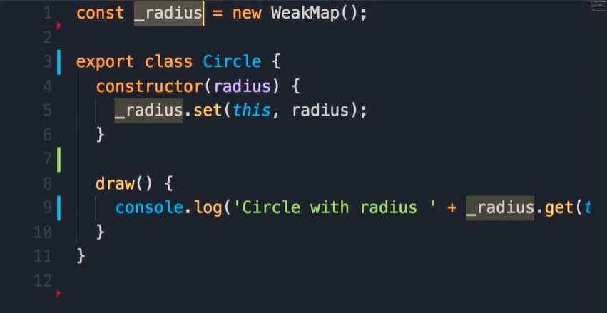
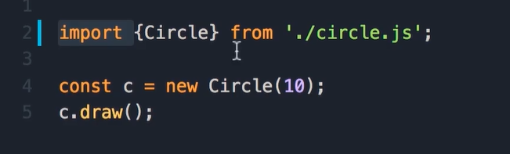
ES6 Modules
Export keyword, we can add it and the class will be exported outside

